Slide 1
Wireless Personal Area Network

Slide 2
Wireless Personal Area Network(WPAN)
A WPAN is a personal, short distance area wireless network for interconnection devices cantered around an individual’s workplace.
WPANs address wireless networking and mobile computing devices such as PCs, PDAs, peripherals,
cell phones, pagers and consumer electronics.
WPAN are also called “short wireless distance network”.
Its typically extends to 33ft(10m) or less.
Due to its limited range, WPAN technology is used mainly as a replacement for cable.
By eliminating the need for cables, data capture products using WPAN technology provide greater convenience, utility and safety. Their low cost and data transfer rate make WPANs ideal for a wide array of retail and industrial applications.
Major technologies of WPAN are Bluetooth(802.15.1) and ZigBee(802.15.4)
WPANs are used to convey information over short distances among a private, intimate group of participant devices
Unlike a WLAN, a connection made through a WPAN involves little or no infrastructure or direct connectivity to the world outside the link

Slide 3
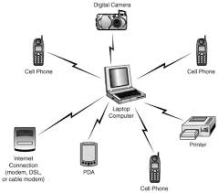
WPAN Network Architecture

Slide 4
WPAN Network Architecture
WPAN architecture consists of the master-slave configuration.
A slave devices and high-end-user interface master devices communicate over an ad hoc multihop network with a data rate of at least 10Mbps
The low-end-user interface devices behave as slave devices of a master devices with a communication requirement below 1 Mbps.
The communication devices act as a gateway between the WPAN and other fixed or wireless network.
All the communication devices have a radio that aids in communication
The trend toward heterogeneous wide area network puts the requirement for supporting multiple radio protocol on the radio of the communication devices. Each of these devices has a programmable computation platform.
There are master devices(Desktop or laptop) and slave device(PDA, mobile, printer, scanner ect).
Master controls transmission schedule of all devices in the WPAN.
Slave can only communicate with the master and can only communicate when granted permission by the master.
At a time only one device transmits by using Time Division Multiple Access technique.
The master gives its clock and device ID to all the slaves in its piconet.
Hopping pattern is determined by device ID. Phase-in hopping pattern is determined by the clock.
The devices in WPAN are very diverse with respect to complexity and communication requirements, the basic structure of all the devices in a PAN is identical. Everybody will have a different set of devices.

Slide 5
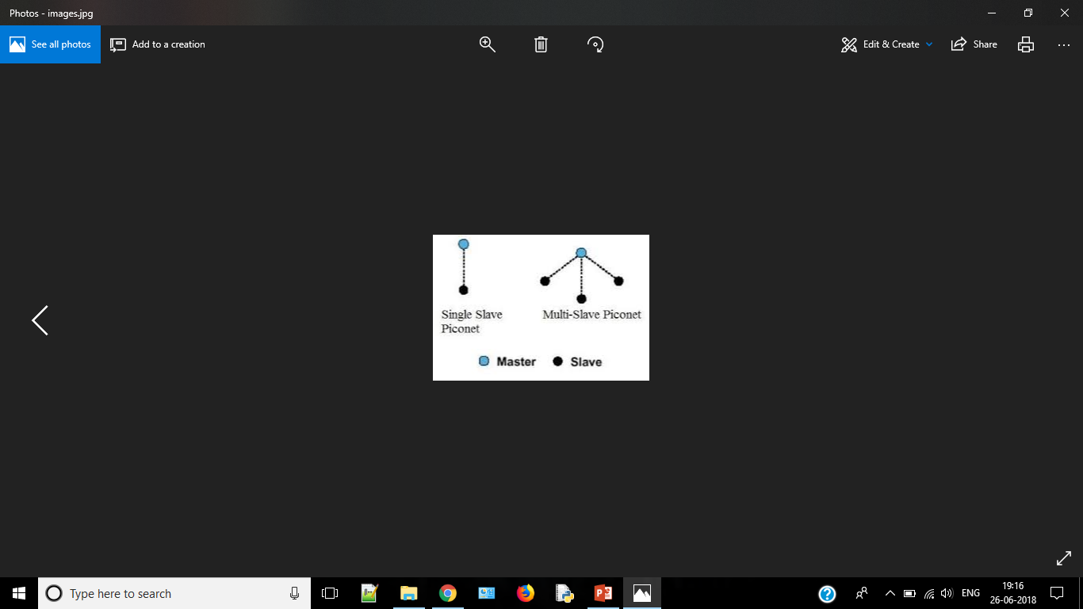
Piconet
A piconet is a WPAN formed by a device serving as a master and one or more devices serving as slaves in the network.
It is connectivity topology of the WPAN.
The master is a device in a piconet whose clock and device addresses are used to define the characteristics of the physical channel.
All other devices in the piconet are called piconet slaves.
At any given time, data can be transferred between the master and any one slave. The master switches rapidly from slave to slave in a round-robin fashion. The device may switch the master-slave role at any time. Slaves communicate only with their master in point-to-point fashion under the control of the master. The master transmissions may be either point-to-point or point-to-multipoint.
Also, besides in an active mode, a slave device can be in the standby modes so as to reduce power consumptions.
A good example of a piconet is the Playstation 3 (PS3) console gaming system. Instead of having wired controllers, the PS3 implements Bluetooth technology to connect up to four controllers at the same time. The main console acts as the master and the controllers act as slaves

Slide 6
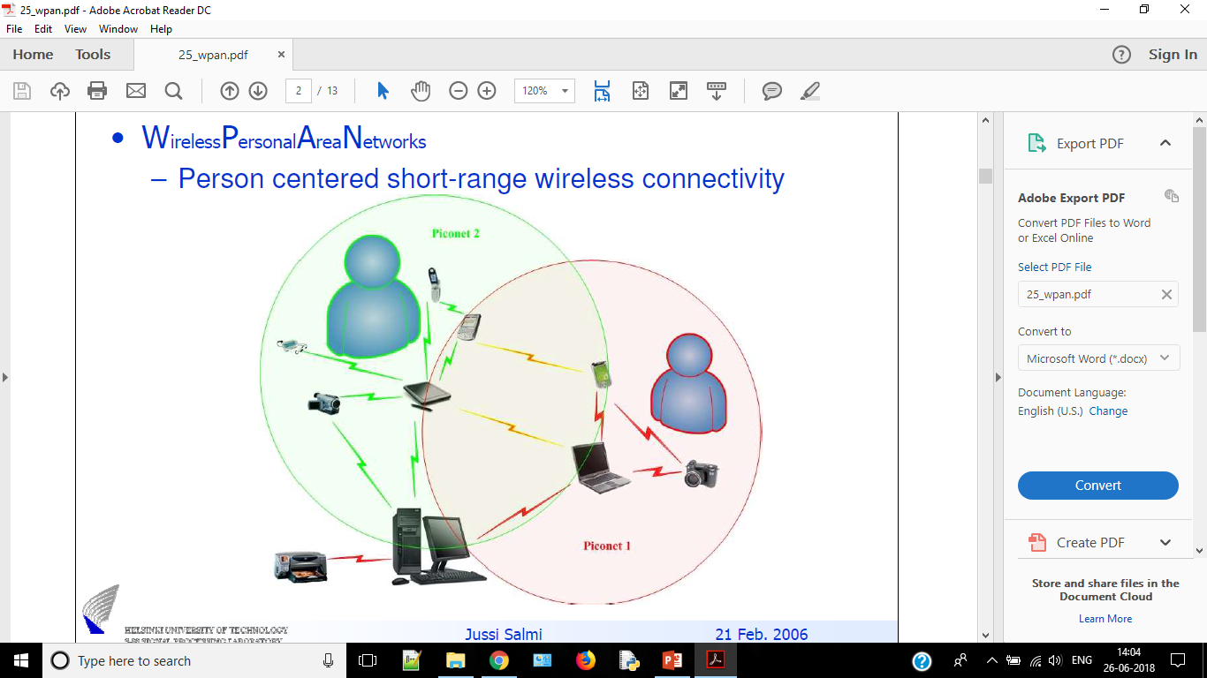
Scatternet
A scatternet is a collection of operational piconets overlapping in time and space.
A device that is member of two or more piconets is said to be involved in a scatternet.
A device may participate in several piconets at the same time.
A device in a scatternet could be a slave in several piconets, but master in only one of them.
The performance of a WPAN highly depends on the scatternet structure.

Slide 7
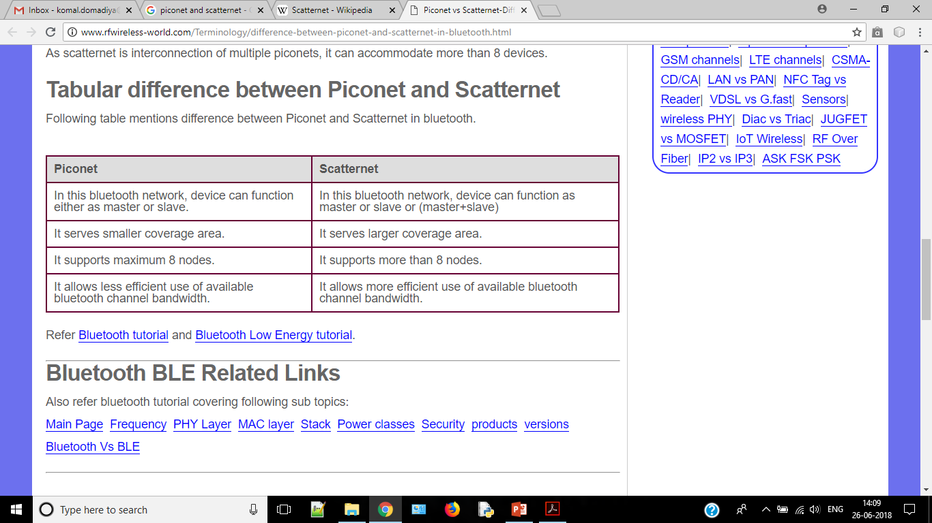
Difference between Scatternet & Piconet
The terms "scatternet" and "piconet" are typically applied to Bluetooth wireless technology.

Slide 8
ZigBee & Bluetooth
The technology ZigBee (also known as IEEE 802.15.4) can be used to connect devices wirelessly at a very low cost and with little energy consumption, which makes it particularly well-suited for being directly integrated into small electronic appliances (like home appliances, stereos, and toys). Zigbee, which operates on the frequency band of 2.4 GHz and on 16 channels, can reach transfer speeds of up to 250 Kbps with a maximum range of about 100 metre
The main WPAN technology is Bluetooth, launched by Ericsson in 1994, which offers a maximum throughput of 1 Mbps over a maximum range of about thirty metres. Bluetooth, also known as IEEE 802.15.1, has the advantage of being very energy-efficient, which makes it particularly well-suited to use in small devices.

Slide 9
WPAN Components
WPAN components range from very low power devices with very low communication possibilities to high-end devices covering the full range of communication standards.
In WPAN some times low-rate devices like sensor, will have a rate in the range of bps whereas a high rate is considered to be in the range of 10Mbps.
To address this wide range of data rates, two basic options are possible to use.
One is to have different physical layers where each addresses a data rate range
(e.g. 10 bps-10 kbps and 10ckbps-10 mbps)
second is to have scalable PHY layers(data rates, power and cost)
Some devices will be more capable and costly then others.
Simple personal devices must be of very low cost and certain less capable devices may be throwaway.
Some more capable devices may incorporate bridge, router or even gateway functionalities as required to support advanced networking features and more traditional environments.
Requirements of WPAN Devices:
The devices in a WPAN must be low cost.
The devices must operate for a long time from simple battery.
Because of their large number, they must be small such that the user is hardly aware of their presence.
The device are small in size.
Ease of use.

Slide 10
WPAN Application
Automotive
Information Sharing
Home automation
Health monitoring
with many advantages including low power consumption, small size, simple protocol, wide compatibility and so on, WPAN has many medical applications including telemedicine system, pervasive and continuous patient monitoring, and wireless-integrated medical devices. For example, in mass casualty or disaster, it is easy to place tiny sensor on each patient to form an ad hoc network by using Bluetooth, relaying continuous vital sign data to multiple receiving devices.
Office automation
Notebook, printer, PDA, desktop computer, fax machine, mouse, keyboard - all can be instantly connected via Bluetooth technology.
Stay completely up-to-date, all the time. Imagine entering the office and your notebook, PDA and desktop address books and calendars will automatically updated to agree with one another. Or, imagine watching your sales
coordinator extract the latest sales data from each member of a sales force as they arrive after a trip
RFID applications
Some of the RFID applications using WPAN technologies find applications in asset tracking, people tracking, inventory traking etc.

